Slide 1
1-800-GOT-JUNK? · SOUTHWIND · SEC
SEC HUDDLE
The climb to first place · June 12, 2026
Power 6
Scenario Pace
People Dev
SOD / EOD
Huddle deck · Sources: DBA Looker Power 6 · SEC Scenario Tracker · PD Competition Hub · Ground Game · EOD Route Board · Safety Tracker

Slide 2
SEC IS GROWING · TWO MARKETS JOIN
Welcome to the SEC
Austin & Dallas come over from LFG — more operators, more saves, more firepower for #1.
Austin
Dallas
from LFG · joining SEC
from LFG · joining SEC
CERTIFIED STAFF
37% · 17 / 46
CERTIFIED STAFF
58% · 29 / 50
GROUND GAME
Deshaun Lee · 3.73 PPJ
GROUND GAME
Hayward Rodgers · 4.29 PPJ
ON THE BOARD
6 reps competing
NEW-MARKET #1
146 pts · 34 jobs · led all of LFG
SCENARIO TRACKER
onboarding now
SCENARIO TRACKER
onboarding now
Sources: PD Competition Hub (certified) · Ground Game (June) · SEC now = 7 markets

Slide 3
DREAM BIG POWER 6 · REGION STANDINGS
We're #2.
Here's #1.
Leader · MIDWEST
100.0 the bar to beat
SEC WEIGHTED SCORE
92.5
THE GAP TO FIRST
7.5 points · one strong month closes it
Revenue $2.42M MTD · AJS #1 in company
Source: DBA Looker — Dream Big Power 6 · weighted score · updated Jun 11, 2026

Slide 4
POWER 6 — REGION LEADERBOARD
Weighted score across all Dream Big regions · SEC = #2
1
Midwest
100
2
SEC
◀ THAT'S US
92.5
3
Florida
77.5
4
LFG
72.5
5
BUOY6
72.5
6
PONY
65
7
APEX
62.5
8
NEE
60
9
BC Canada
52.5
10
NYC
52.5
Note: SEC scope is expanding to include Austin + Dallas (today in LFG, #5) — folded into next month's region roll-up.
Source: DBA Looker — Power 6 · regions only (company & system rollups excluded) · Jun 11, 2026

Slide 5
SEC POWER 6 SCORECARD
Six weighted metrics · where we win and where we climb
REVENUE vs GOAL
GROW
LABOR TARGET
WIN
RESI AJS %
WIN
+11.0% 25% wt
+0.95% 25% wt
70.1% 15% wt
Beating goal — but #1 runs +17.6%
Under target — favorable
+4.1 var · #1 in the company
RESI CANCELLATION
FIX
LOCO CANCELLATION
WATCH
COMPLAINT %
EVEN
36.5% 15% wt
19.5% 15% wt
1.0% 5% wt
-0.5 var · trim toward 35%
+0.5 var · #1 sits at 18.8%
Right on target
Source: DBA Looker — Power 6 · SEC region · vs target & vs Midwest (#1) · Jun 11, 2026

Slide 6
THE PATH TO FIRST PLACE
92.5 → 100 · +7.5 points · win revenue, cut cancellations, hold our people lead
1
WIN REVENUE
+11.0% vs goal → chase #1's +17.6%. Biggest weight (25%) and our biggest gap.
2
CUT RESI CANCELLATIONS
36.5% → under 36%. Save the job at the door (15% of score).
3
TRIM LOCO CANCELLATIONS
19.5% → under 18.8% like #1. Tighten dispatch & confirms (15%).
4
PROTECT OUR LEADS
Resi AJS #1 (70.1%) + Labor (+0.95%) = 40% of score we already own.
Source: DBA Looker — Power 6 weighted-score model · SEC vs Midwest gap analysis

Slide 7
⚡ SEC SCENARIO PACE — ALL 5 AHEAD
June 11 · expected pace 33.3% · scenarios feed our #1 AJS
Northern Virginia
Virginia Beach
Washington DC
Atlanta
Richmond
61.3%
55.6%
43.3%
42.6%
41.2%
AHEAD OF PACE
AHEAD OF PACE
AHEAD OF PACE
AHEAD OF PACE
AHEAD OF PACE
RAN / GOAL
38 / 78
RAN / GOAL
15 / 34
RAN / GOAL
29 / 84
RAN / GOAL
40 / 118
RAN / GOAL
14 / 42
VS EXPECTED
+28% ahead
VS EXPECTED
+22% ahead
VS EXPECTED
+10% ahead
VS EXPECTED
+9% ahead
VS EXPECTED
+8% ahead
NEW TO SEC Austin 37% certified (17/46) · Dallas 58% certified (29/50) — onboarding to the scenario tracker
Source: SEC Scenario Tracker (Jun 11) · Austin/Dallas certified-staff from PD Competition Hub

Slide 8
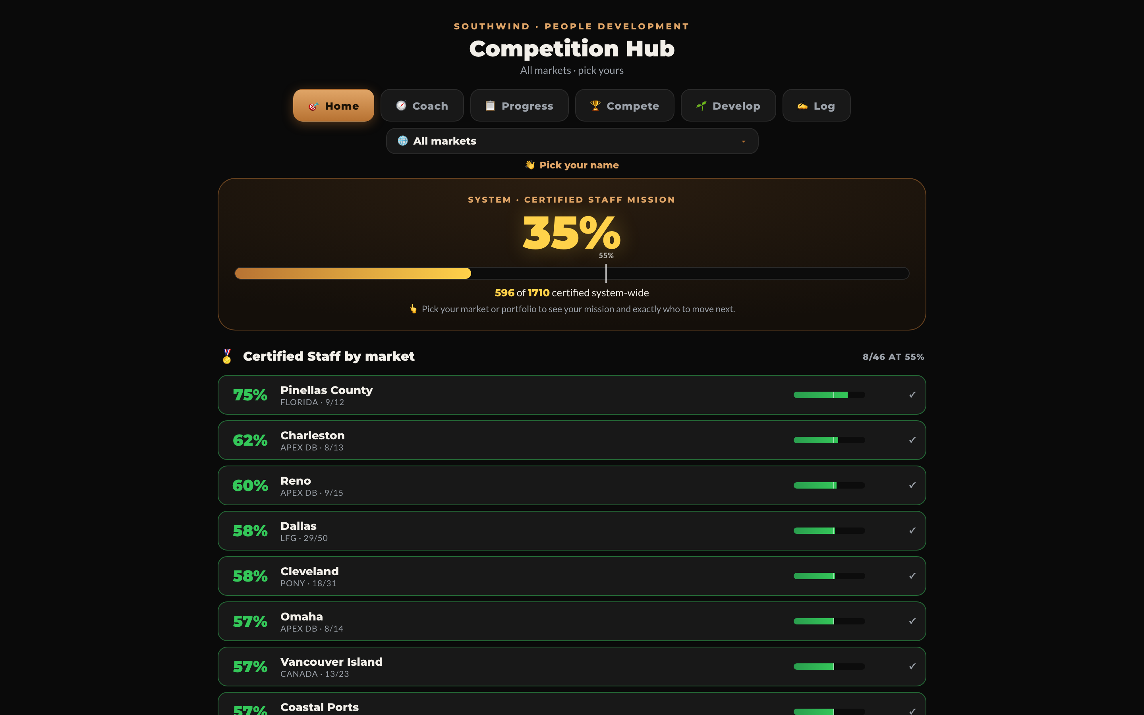
PEOPLE DEVELOPMENT · THE ENGINE
35% certified —
and climbing.
pd.dreambigsouthwind.com
Certified staff is where SEC already leads the
company (Resi AJS #1). Scenarios → quality →
AJS → Power 6. Keep the by-market climb going.
System certified
35%
Top market (Pinellas)
75%
Scenarios drive
AJS #1
Source: PD Competition Hub — Home · System certified-staff mission

Slide 9
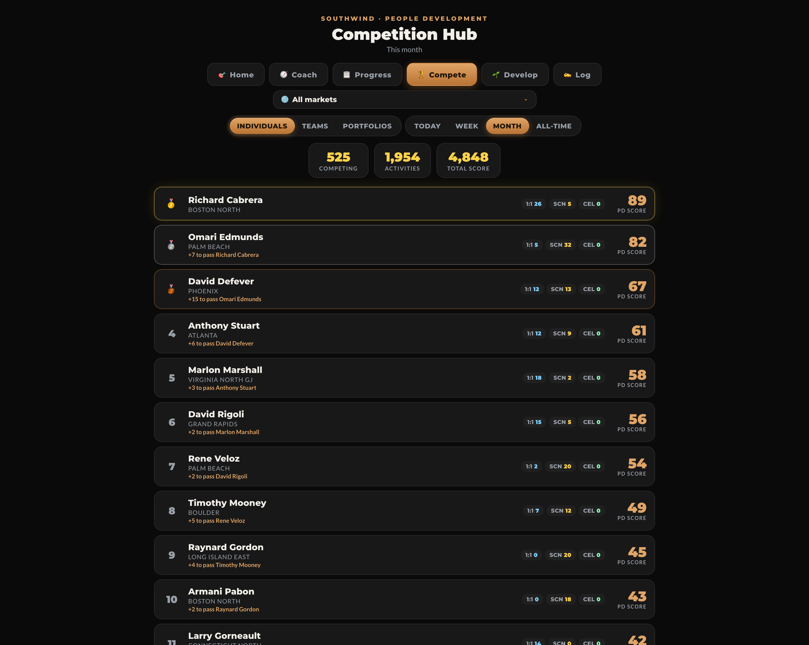
THE COMPETITION IS LIVE
525 people competing · 1,954 activities · SEC names already on the board
pd.dreambigsouthwind.com/compete
WHO'S REPRESENTING SEC
Anthony Stuart
Atlanta
61
Marlon Marshall
Virginia North GJ
58
THE ASK
Every SEC operator logs
one scenario this week.
Climb the board, climb Power 6.
Source: PD Competition Hub — Compete · individual leaderboard (this month)

Slide 10
PD COMPETITION — PORTFOLIO RANKING
This month · 9 portfolios · SEC is #2 — one push from first
1
LFG
877 PD
SEC · #2 OF 9
2
SEC
849 PD
849 PD score
3
NEE
675 PD
28 behind LFG (877) — catchable
4
APEX
650 PD
1:1 sessions
70 — most in company
5
Midwest
592 PD
Scenarios
275 (LFG 309)
6
Florida
447 PD
7
Canada
341 PD
CEL
0 (LFG 1, FL 2)
8
PONY
228 PD
Close it →
more scenarios + log CELs
+ Austin & Dallas now strengthen SEC
9
NYC
204 PD
Source: PD Competition Hub — Compete · Portfolios · this month · SEC now includes Austin + Dallas

Slide 11
GROUND GAME — LEADERBOARD
June · ranked by PPJ (points per job) · SEC owns the top of the board
1
Bryan Clonts 👑
16.45 PPJ
SEC · Atlanta · 30 jobs · 493.5 pts
SEC OWNS THE FIELD
2
Som Luangphakdy
13.11 PPJ
4 of top 5
are SEC operators
SEC · Atlanta · 9 jobs · 118 pts
3
Aaron Scott
12.98 PPJ
SEC · Atlanta · 32 jobs · 415.5 pts
4
Joseph Holmes
10.62 PPJ
👑 #1 Bryan Clonts
16.45 PPJ · 493.5 pts
on 30 jobs
APEX · LA South · 33 jobs · 350.5 pts
5
Ajani Martin
10.55 PPJ
SEC · Atlanta · 32 jobs · 337.5 pts
6
Antonio Mann
8.94 PPJ
PPJ = points per job —
rewards quality knocks,
not just volume.
PONY · Allentown · 42 jobs · 375.5 pts
7
Kevin Bolling-Figueroa
6.96 PPJ
PONY · Allentown · 28 jobs · 195 pts
8
Jacob Loggins
5.00 PPJ
SEC · Atlanta · 25 jobs · 125 pts
+ NEW SEC MARKETS Dallas — Hayward Rodgers 4.29 PPJ (led all of LFG) · Austin — Deshaun Lee 3.73 PPJ · 12 reps added
Source: Ground Game — groundgame.dreambigsouthwind.com · system board · June 2026 · incl. Austin + Dallas (from LFG)

Slide 12
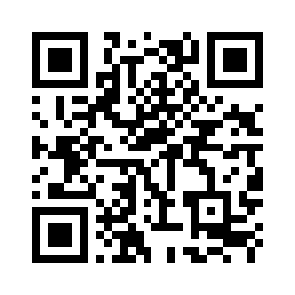
NEW APP · SCAN & PRESENT
PD Competition Hub
pd.dreambigsouthwind.com
People Development as a live competition —
standings, scenarios & certifications, gamified.
Certified-staff % by market, portfolio & system
Scenarios, CEL, OSL & 1:1 in one place
Standings, achievements & head-to-head duels
Prefilled logging — pick your name & go
SCAN TO OPEN
pd.dreambigsouthwind.com
Open on your phone, pick your
name — your home personalizes.
Live: pd.dreambigsouthwind.com

Slide 13
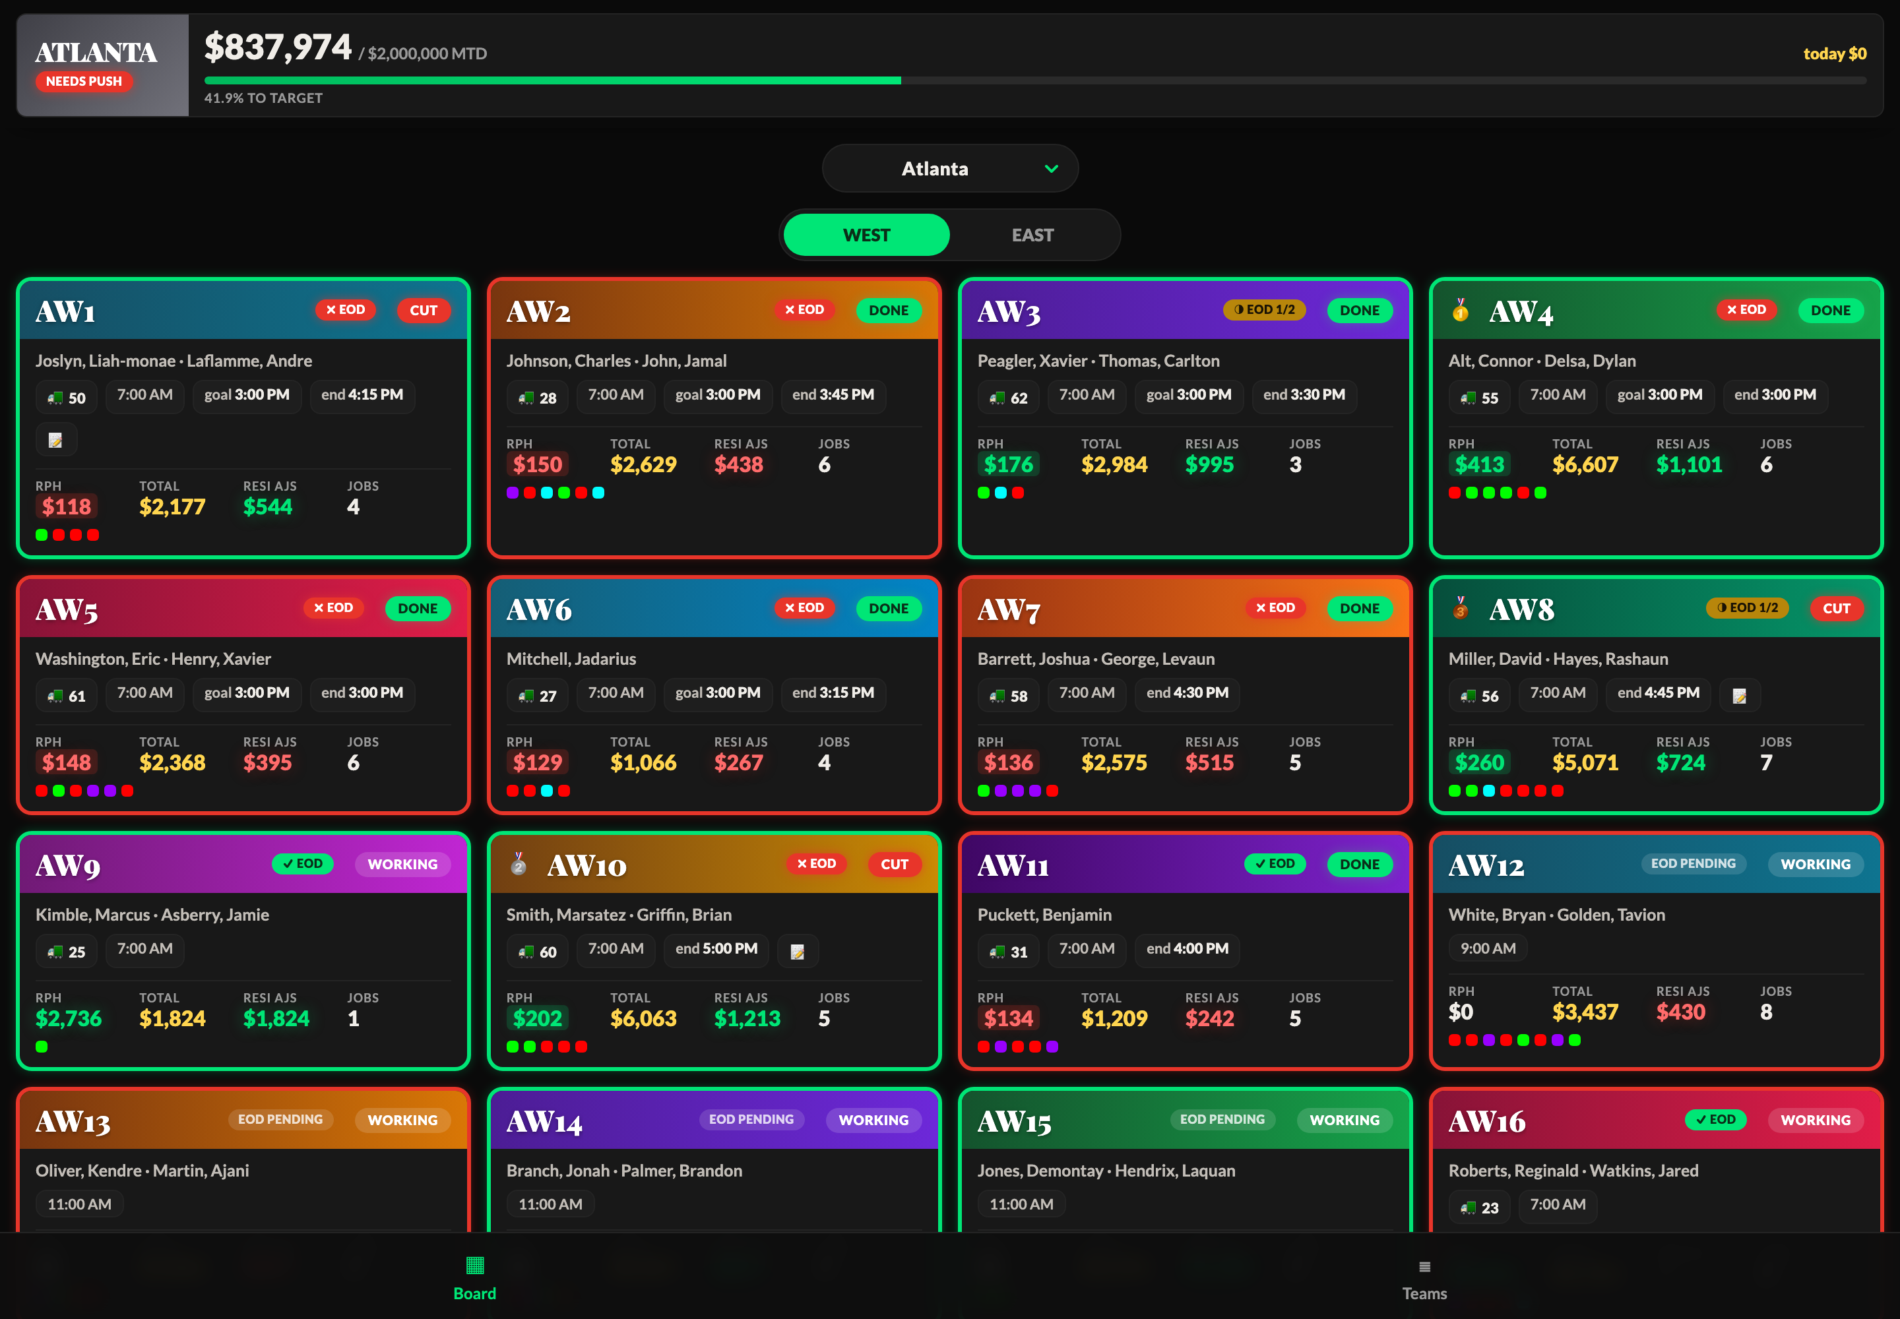
SOD / EOD — OWN THE DAY
Execution discipline that protects revenue and kills cancellations — the exact gaps in our Power 6
eod route board · Atlanta
Start of Day
SOD
Crews check out — trucks, paperwork, routes confirmed
RUN
Live Execution
Routes tracked live — revenue & completions
EOD
End of Day
Completions logged, junk sheet triggers, day closed
READ THE BADGES
✓ SOD
checked out & rolling
WORKING
live on route now
✓ EOD
day complete & logged
✗ CUT
flagged — follow up
Source: EOD Route Board — per-route SOD/EOD status (live)

Slide 14
🏆 SEC SAFETY CHAMPIONSHIP
✓ SAFETY FIRST
June 2026 · Safety drives success — together, we win
RANK
MARKET
SAFETY
EVENTS
MILES >20K
MI / EVENT
DVIR >75%
ACCIDENTS
NOVA
98
16
29,075
1,817
93%
0
1
Washington DC
93
21
19,761
941
91%
0
2
VA Beach
91
24
8,970
373
63%
0
3
Richmond
90
61
34,987
573
58%
0
4
Atlanta
92
98
55,742
568
69%
1
5
NOVA leads at 98 · just one at-fault accident across all of SEC
DRIVE SAFE · WORK SAFE · GO HOME SAFE
Source: SEC Safety Championship Tracker — June 2026 (Motive safety scores, events, DVIR, at-fault accidents)

Slide 15
SEC · THE CLIMB TO FIRST
First place is 7.5 points away.
WIN REVENUE
CUT CANCELLATIONS
RUN SCENARIOS
OWN SOD / EOD
We already own the people game — AJS #1, labor tight, all 5 markets ahead of pace.
Close revenue and cancellations, and SEC takes #1.
SEC Huddle · June 12, 2026 · Dylan Kehr — Area Director · 1-800-GOT-JUNK · Southwind

